Slide 1
Taehwa, Greater Noida Contact Person name. Mr. - Atul
Kudamm Corporation
Harmetting Orientation Inspection
Application Engineer Muzammil Khan
Date :01/06/2023

Slide 2
Application details -
Objective :Harmetting Inspection
Presales input :
 | At the time Trial | Required
FOV (mm) | 80 x 50 | 80 x 50
WD (mm) | 220 | 220
Communication with Controller | TCP / IP | TCP I/P
SKUs/ Models | Single | Single
Speed (Parts/ min) | Stationary | Stationary

Slide 3
Result Image – 01, OK
Orientation OK

Slide 4
Result Image – 02, OK
Orientation - OK

Slide 5
Result image -3, NG
Orientation - NG

Slide 6
Result image -4, NG
Orientation - NG

Slide 7
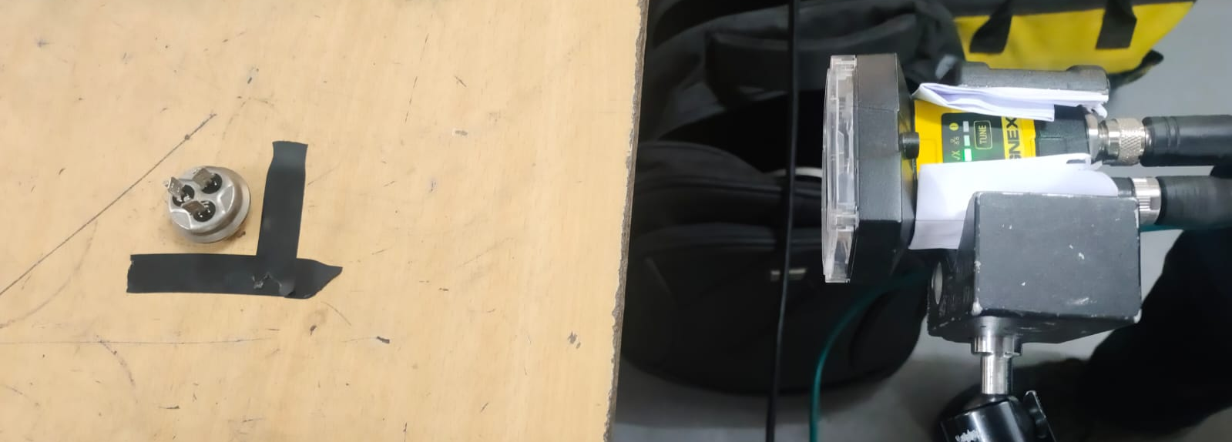
Hardware Setup -
Vision camera – IS2000M with
red light
WORKING DISTANCE - 220MM

Slide 8
Demonstration Summary :
*Trials summary (Trial done on total 1 no. of part.
*Customer comments.

Slide 9
Technical Specification :
*Cognex IS 2000 Series Camera
Suggestions:
*No. of Models – Single
*All Models should come in Camera Field Of View.
*Camera Triggered Required from PLC / Button / Sensor – Client Scope.
*Camera Mounting Bracket – Kudamm Scope.
*Camera Stand – Customer scope..
*Part should be properly fixture - Client Scope
*SMPS 24VDC – Client Scope
*For Programming Laptop will be needed.

Slide 10
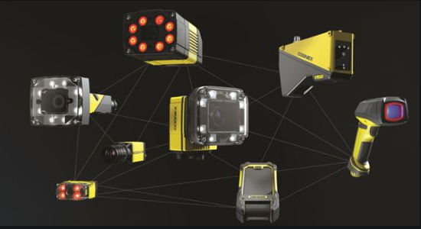
Kudamm Corporation
+91 7290090381
muzammil@kudammcorp.in

