Slide 1
Taehwa, Greater Noida Contact Person : Mr. Yadu Sharma Cognex SE : Mr. Abhishek Sarmah
Kudamm Corporation
To Detect Compressor Child Parts
Application Engineer Muzammil Khan
Date : 20/09/2022

Slide 2
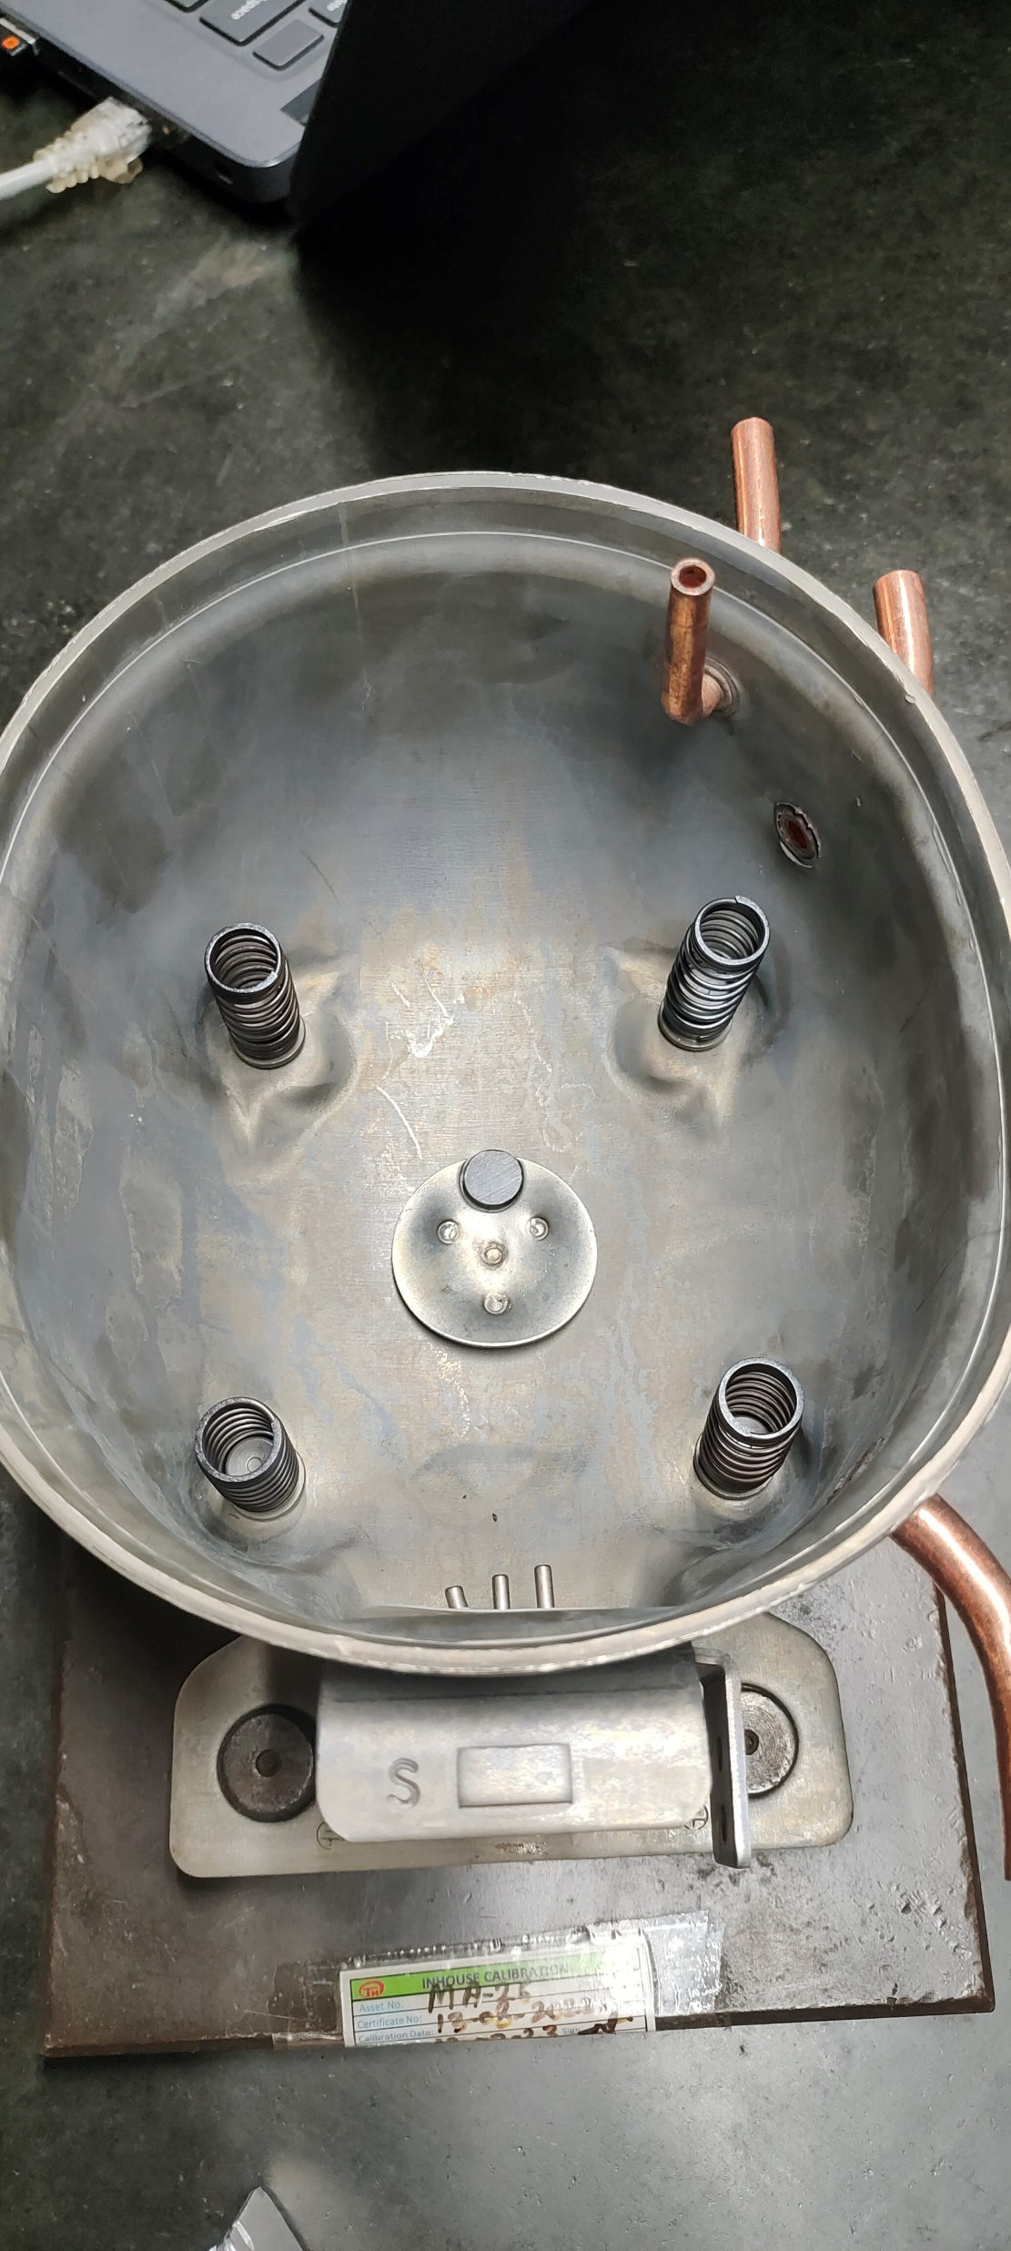
Application details -
Objective : To Detect compressor Child Parts.
Springs (4 No’s)
Magnet (1 No’s)
Insulator (1 No’s)
Presales input :
 | At the time Trial | Required
FOV (mm) | 200 x 150 | 200 x 150
WD (mm) | 100 | 100
Communication with Controller | - | -
SKUs/ Models | Single | Single
Speed (Parts/ min) | Stationary | Stationary

Slide 3
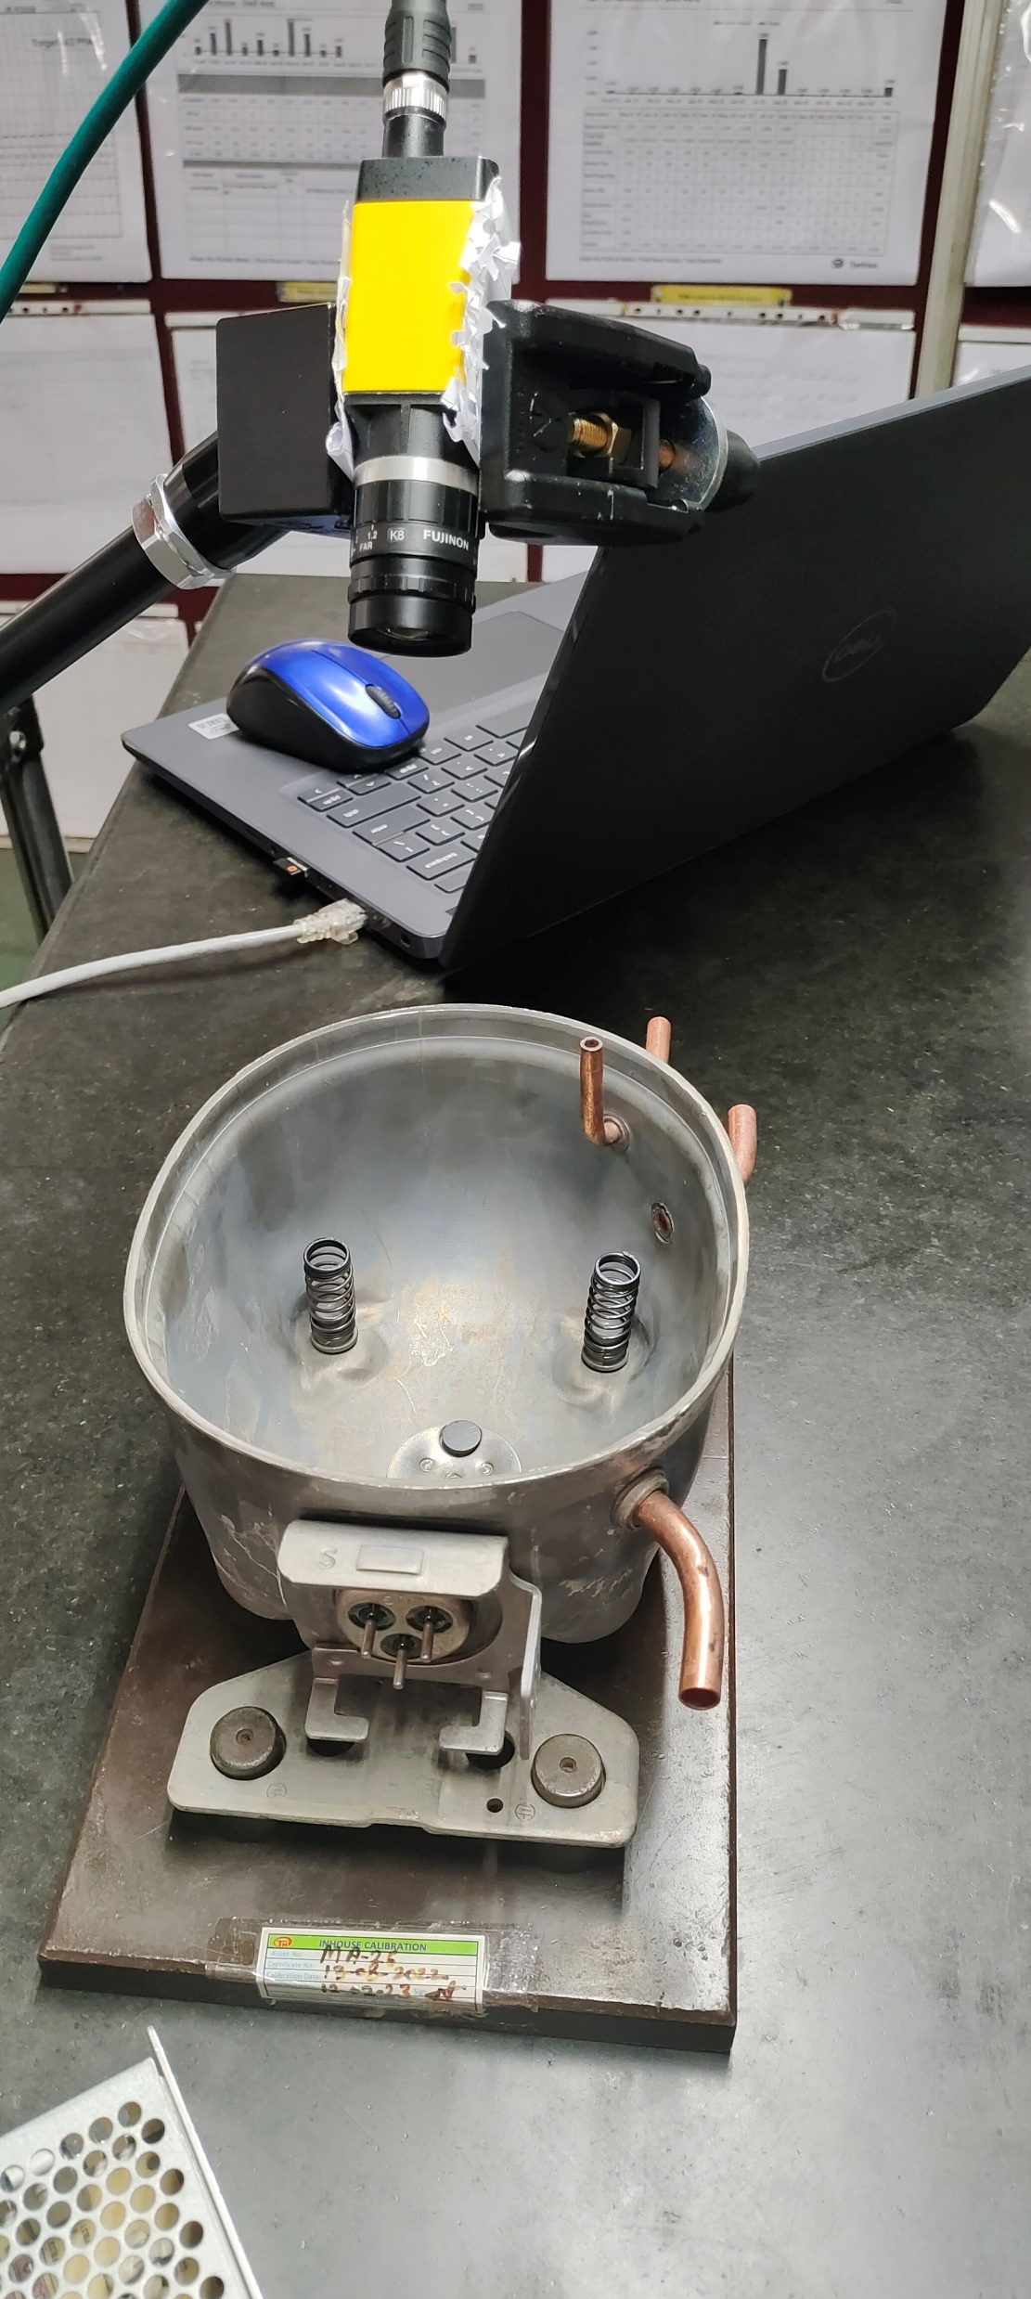
Hardware Setup -
camera– IS8000
Lens – 6 MM

Slide 4
Result image -1 OK

Slide 5
Result Image – 02 NG (SPRING MISS)

Slide 6
Result Image – 03 (SPRING & MAGNET MISS)

Slide 7
Result image -4 NG (SPRING , MAGNET & INSULATOR MISSING)

Slide 8
Demonstration Summary :
*Trials summary (Trial done on total 1 no. of part)
*Trial done on BS100 Model
*Customer comments.
Suggestions:
*No. of Models – Single
*All Models should come in Camera Field Of View.
*Camera Triggered Required from PLC / Button / Sensor – Client Scope.
*Camera Mounting Bracket – Kudamm Scope.
*Camera Stand – Client scope.
*Part should be properly fixture - Client Scope
*SMPS 24VDC – Client Scope
*For Programming Laptop will be needed.

Slide 9
Technical Specification :
*Cognex IS8000M Camera
*External Machine Vision Light
*C-Mount Lens

Slide 10
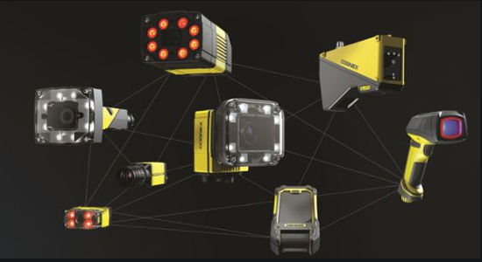
Kudamm Corporation
+91 7290090381
muzammil@kudammcorp.in

