Slide 1
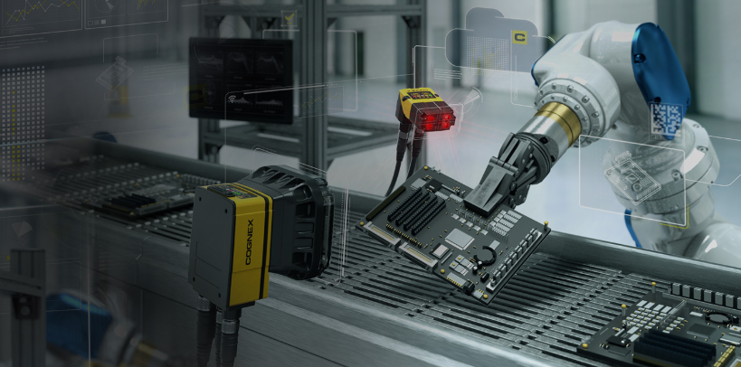
Jay Ushin, Sec-18, Gurgaon Contact Person : Mr. Amit Dhimman
Kudamm Corporation
To detect color of FD, BD & Fuel Clips
Application Engineer Muzammil Khan
Date : 08/07/2023

Slide 2
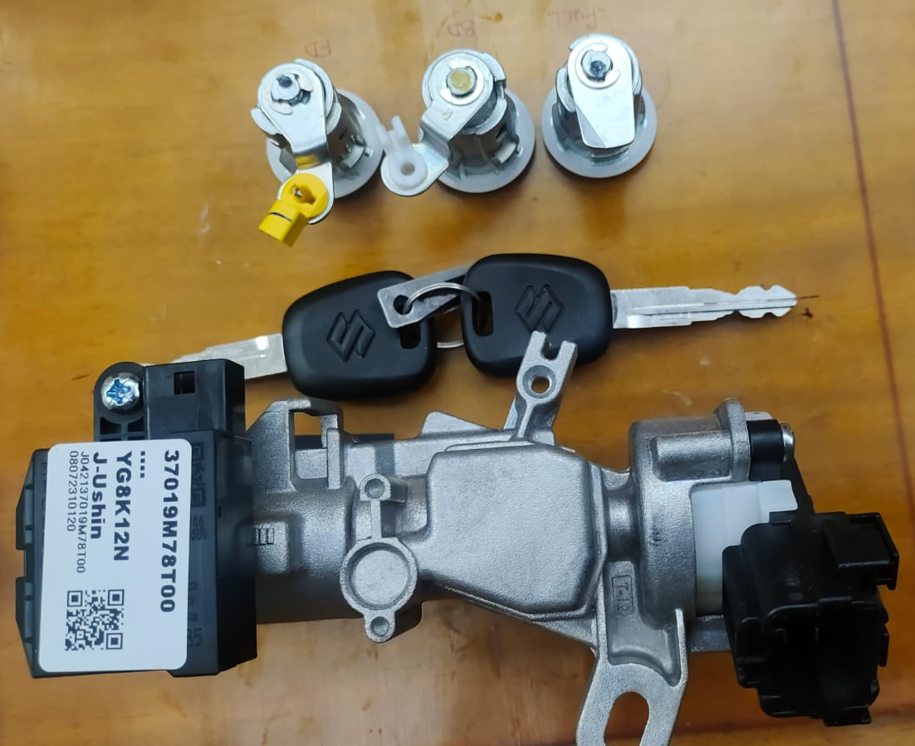
Application details -
Objective : Color Detection of FD , BD , Fuel
Suzuki Logo – 2 No’s
Color – White, Black & Yellow
Presales input :
 | At the time Trial | Required
FOV (mm) | 120 x 100 | 120 x 100
WD (mm) | 250-300 | 250- 300
Communication with Controller | - | -
SKUs/ Models | Single | Single
Speed (Parts/ min) | Stationary | Stationary

Slide 3
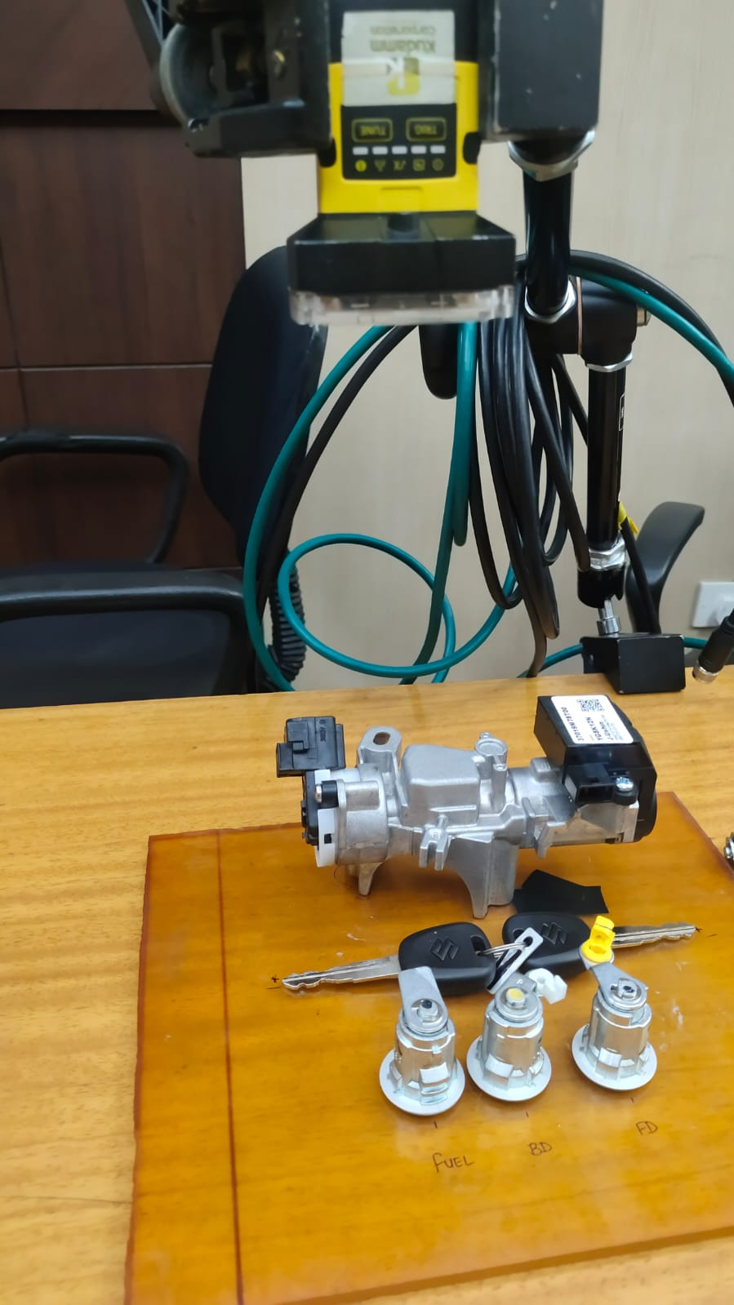
Hardware Setup -

Slide 4
Result Image – 01 OK Image
All Parameter’s are OK

Slide 5
Result Image – 02 OK Image
All Parameter’s are OK

Slide 6
Result Image – 03 NG Image
FD Black clip is missing

Slide 7
Result Image – 04 NG Image
FD, BD Black clip is missing & Yellow clip position change.
.

Slide 8
Demonstration Summary :
*Trials summary (Trials done on total 2 nos. of parts..
*Customer comments.
Operating Philosophy:
*Operator will load Part on Fixture & Press Start Button. Camera will trigger. If all parameter’s
are Present then Camera will declare OK. If any one Parameter’s is missed it will declare Fail.

Slide 9
Technical Specification :
*Cognex IS 2000C Camera.
Suggestions:
*No. of Models – Single
*All Models should come in Camera Field Of View.
*Camera Triggered Required from PLC / Button / Sensor – Kudamm Scope.
*Camera Mounting Bracket – Kudamm Scope.
*Camera Stand – Customer Scope
*Table bed for inspection – Customer Scope
* Clip position’s will be fixed – Customer Scope

Slide 10
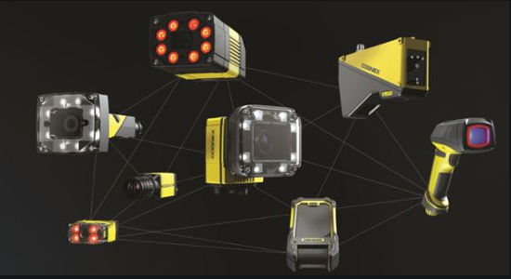
Kudamm Corporation
+91 7290090381
muzammil@kudammcorp.in

