Slide 1
Measuring Light Curtains

Slide 2
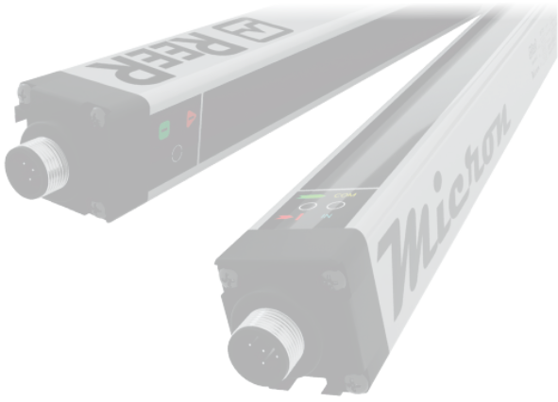
What is a Measuring Light Curtain ?
The measurement light screens (or array or curtain) have been developed for industrial automation applications where it is necessary to detect, measure or recognize objects. Measurement and detection light screens are used for measurement, automation and control. Depending on the number and position of the interrupted beams, the Micron measurement light screen communicates relevant information to PC or PLC.
What a Measuring Light Curtain is capable of :
Detect the presence or absence of objects
Perform a count
Detect a position
Detect a shape or a profile
Measure dimensions

Slide 3
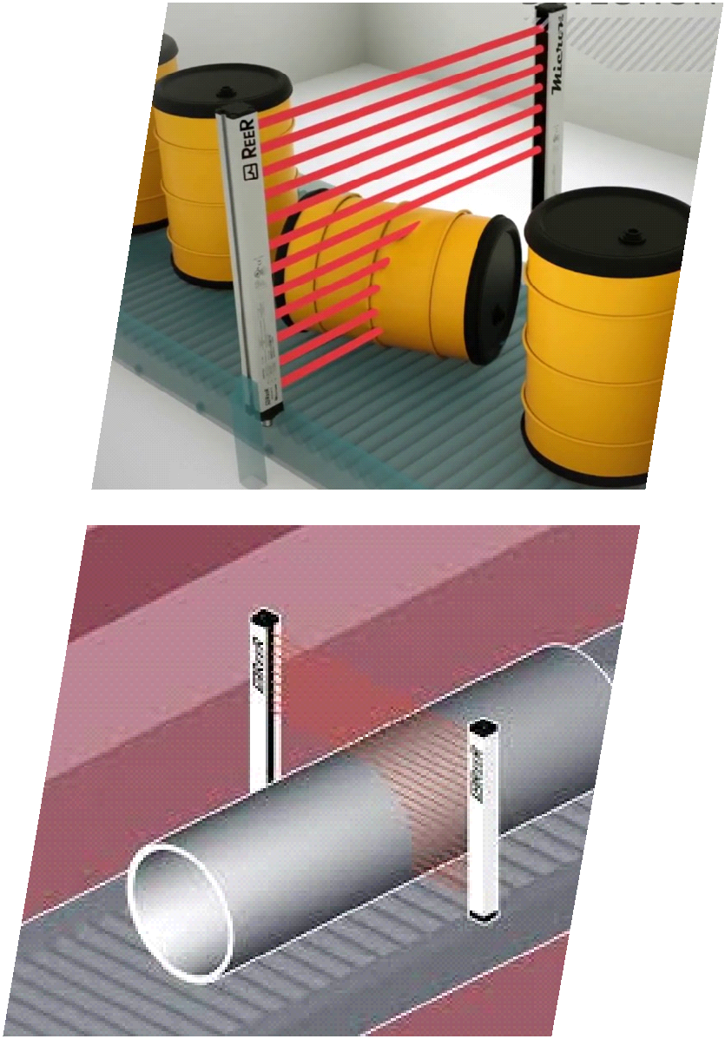
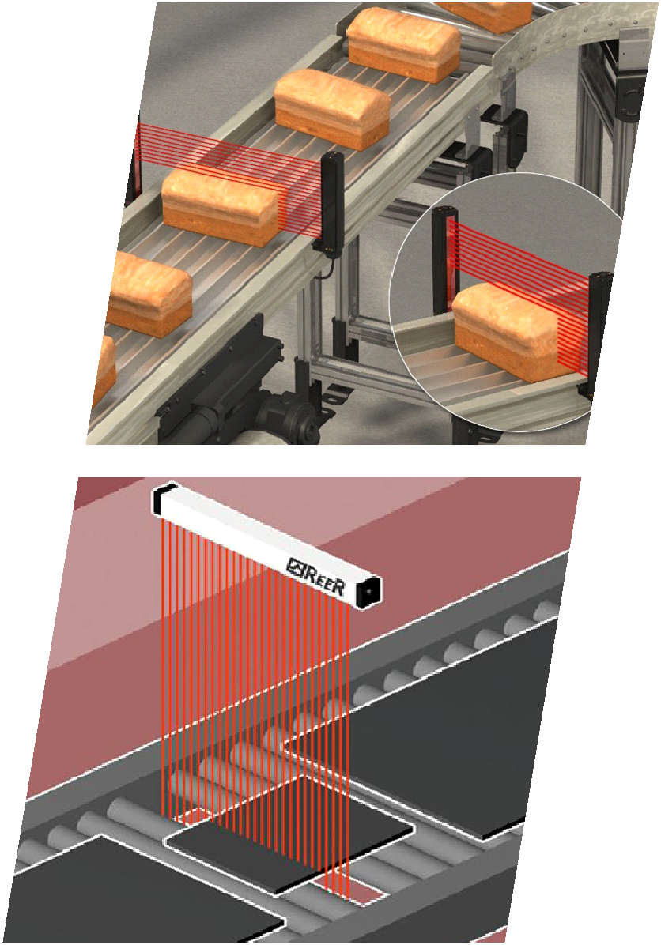
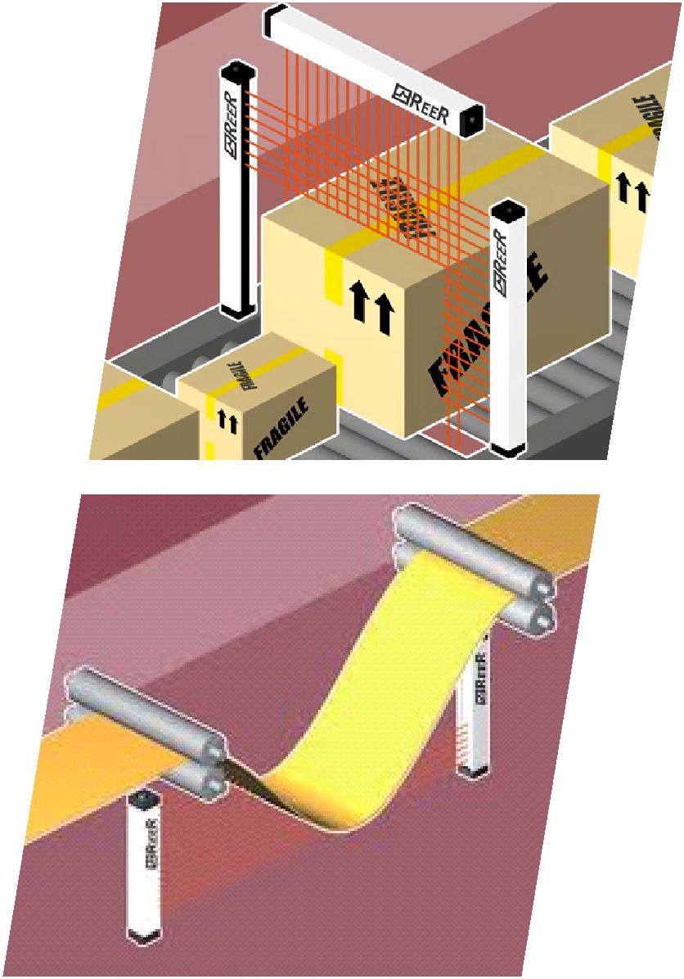
APPLICATIONS

Slide 4
Installation at Toll Plaza

Slide 5
Beam
Spacing

Slide 6
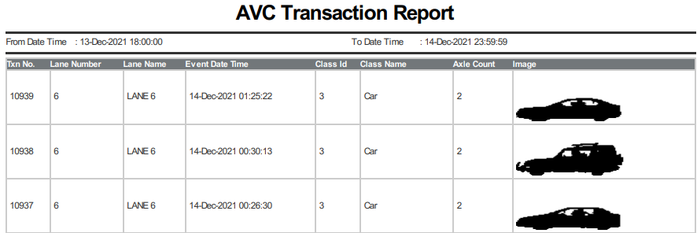
Customized
Application
Software
Vehicle
Contouring

Slide 7
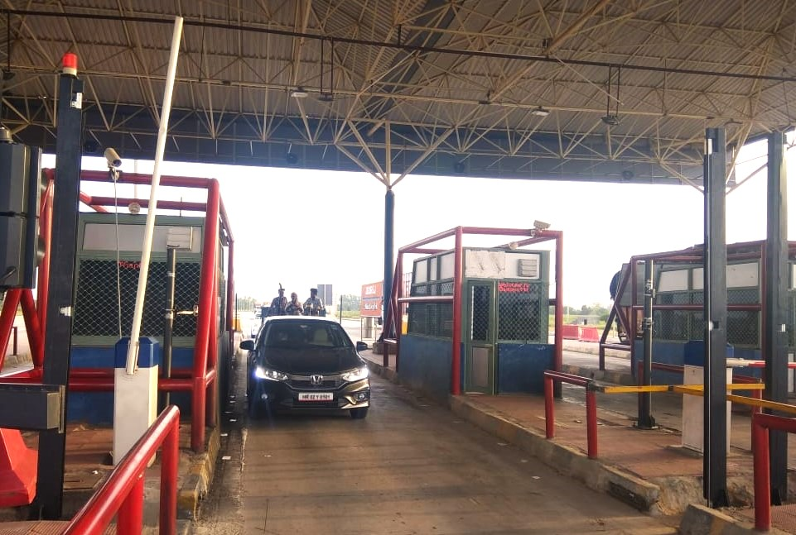

Slide 8
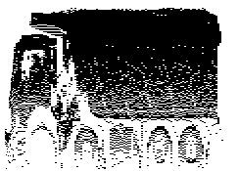
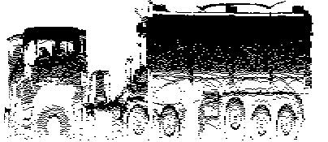
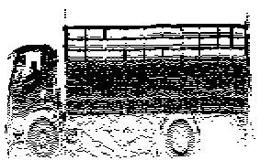
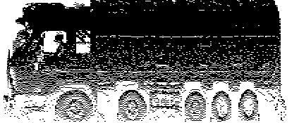
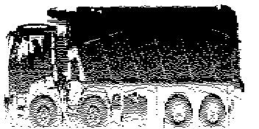
Vehicle
Contouring
Images generated from Software

Slide 10
Thank You

